Slide 1
EMG Gesture Recognition
INTERACTIVE PHYSICAL THERAPY FOR CEREBRAL PALSY REHABILITATION
Jose Colli Alfaro
Claire Lizotte
Tharmiga Loganathan
Christopher Tam

Slide 2
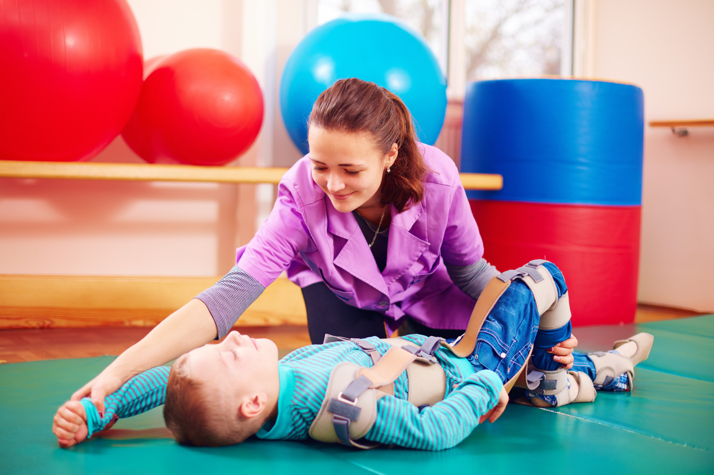
Purpose
2.6-3.2
Out of every 1000 children are diagnosed with CP
#1
Cause of childhood motor disability
Notes:
Cerebral Palsy (CP) is the leading cause of childhood motor disability. It is a group of permanent movement disorders which can result in impaired movement, abnormal reflexes, and muscle stiffness. Gamifying rehabilitation exercises can help children with CP stay engaged through many repetitive physical therapy sessions.

Slide 3
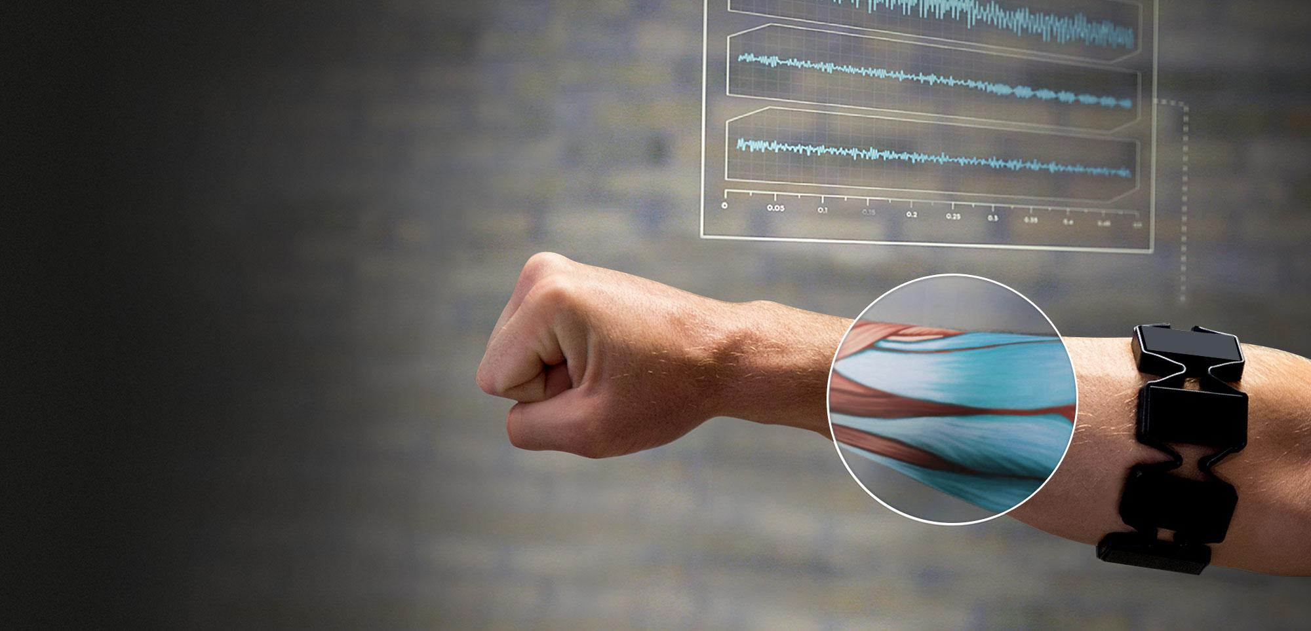
Objective
Notes:
An important step to building interactive software for CP therapy is taking electromyography (EMG) muscle activity data and classifying it into gestures and movements.

Slide 4
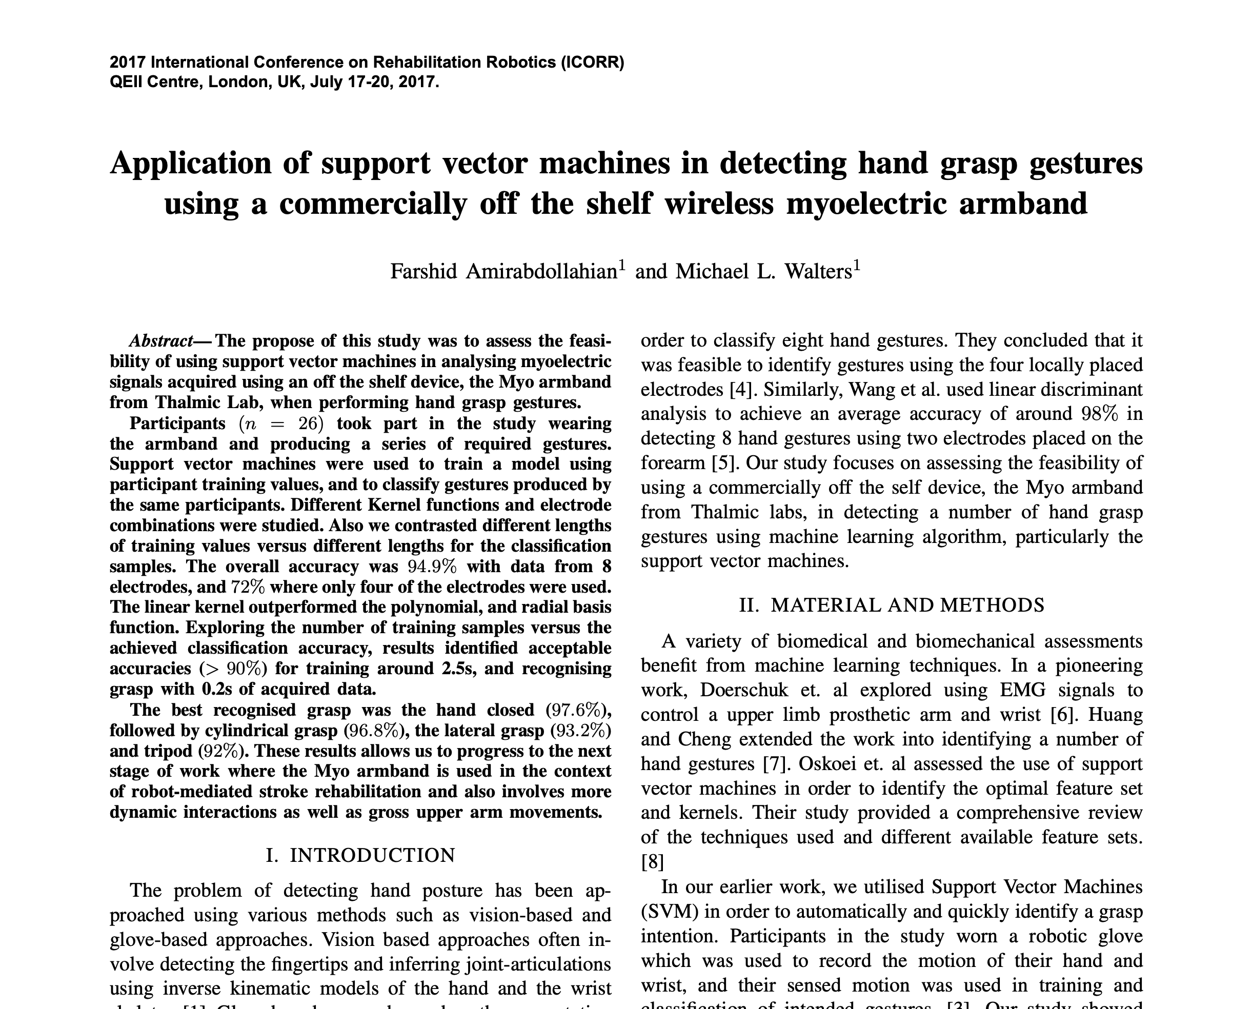
Related Work
Notes:
Previous work in the field of EMG gesture recognition have tried to classify gestures using different algorithms. One study used SVM to classify four hand gestures with 94.9% accuracy. However, results were based on limited training data.

Slide 5
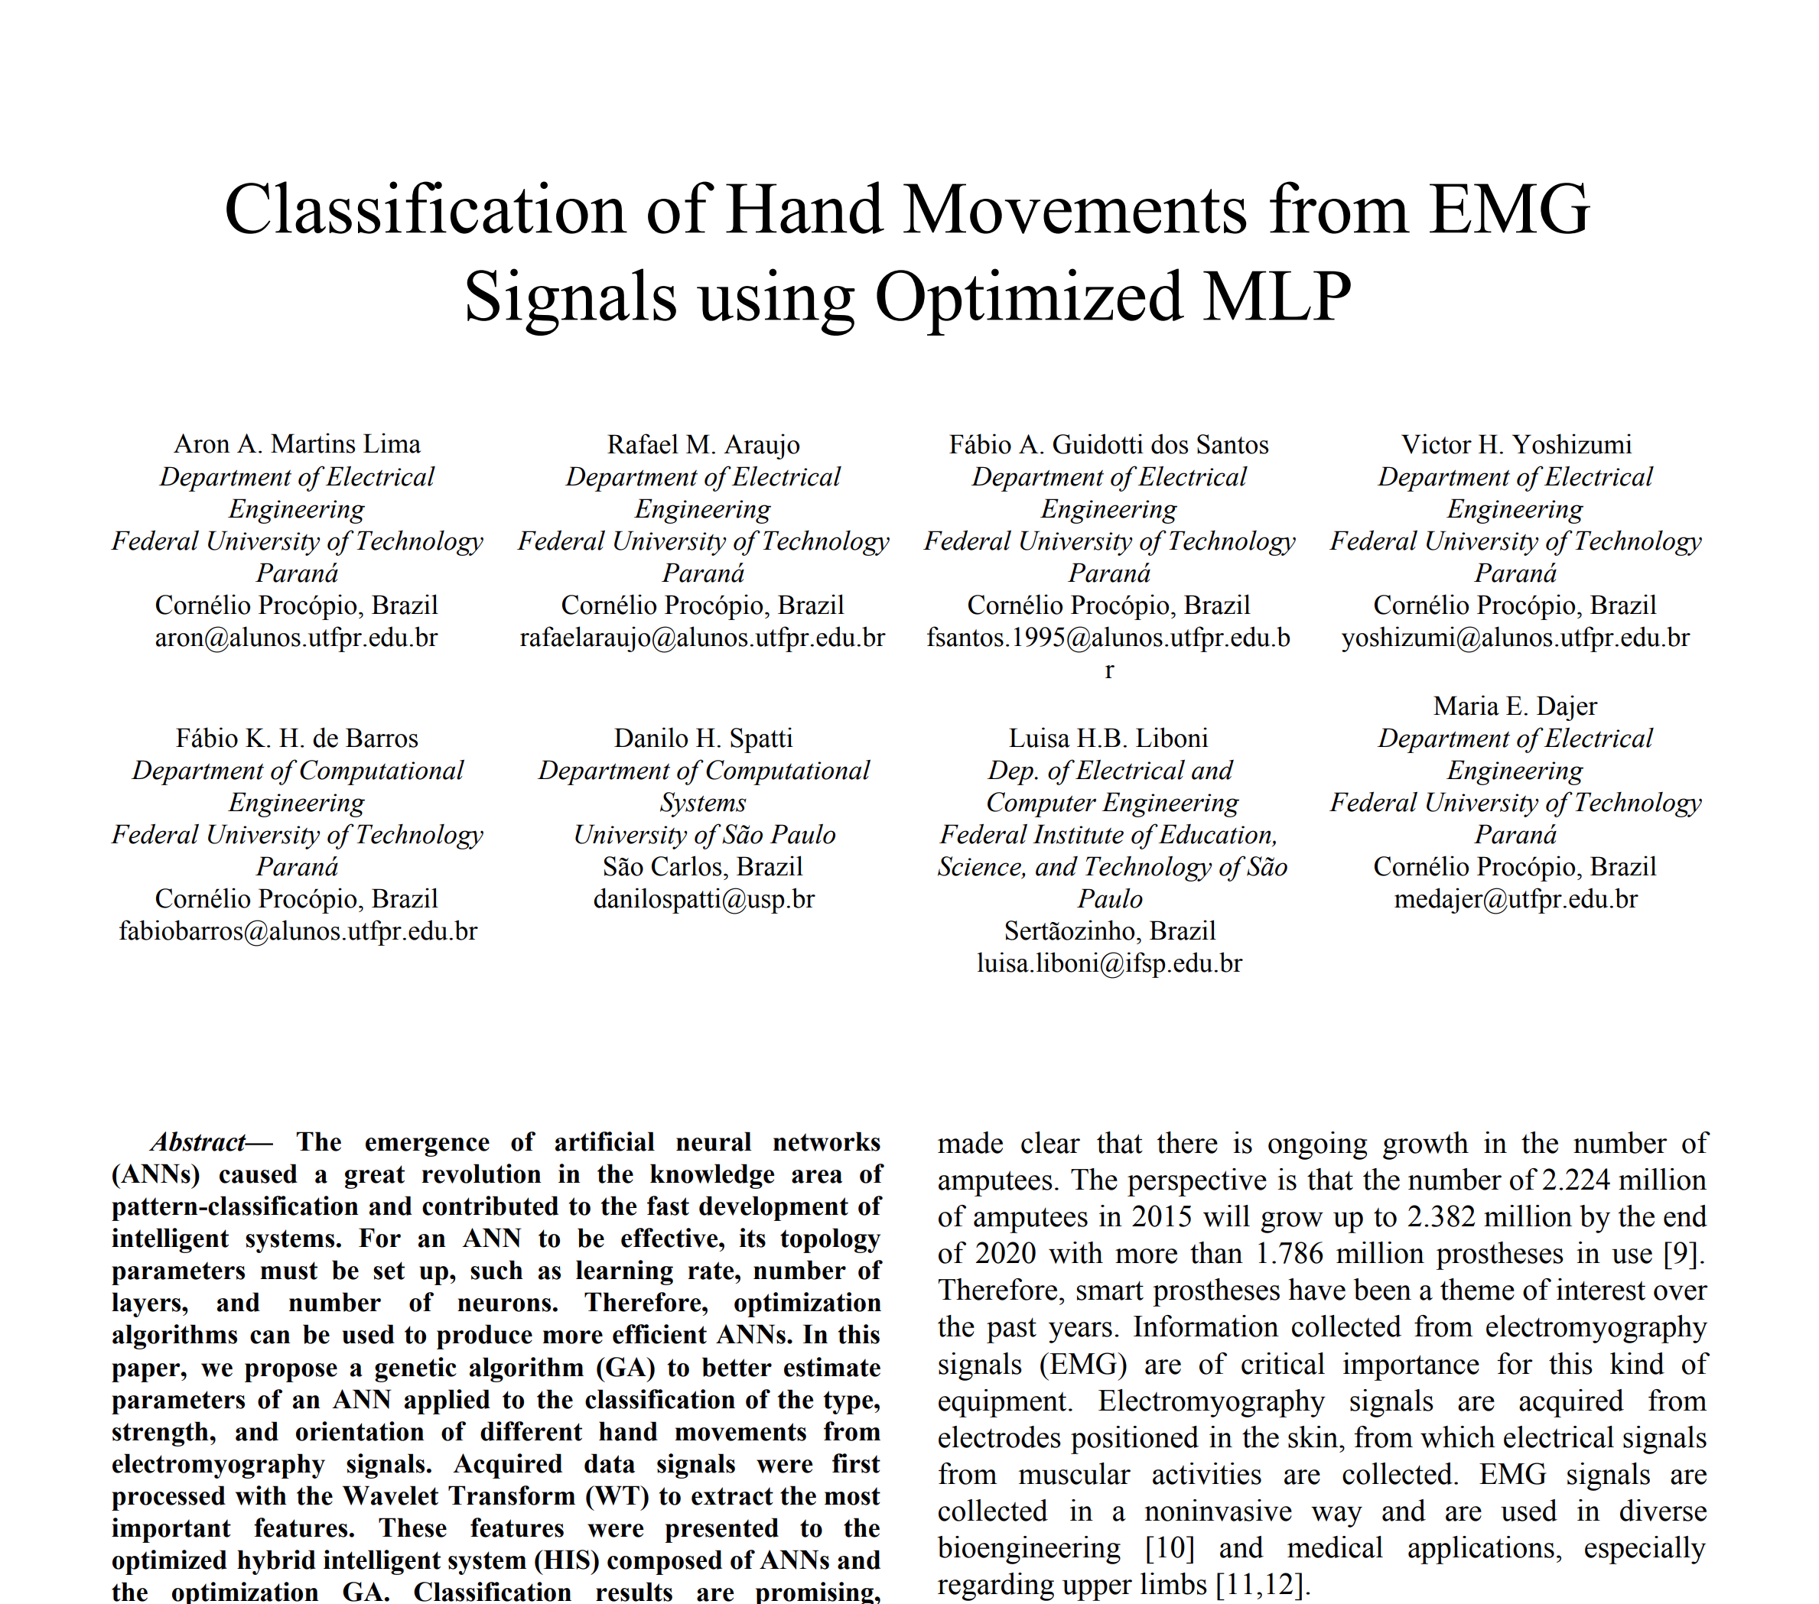
Related Work
Notes:
Six hand gestures in this study were classified using MLP networks in this study with 98.3% accuracy. However, training time was very high because it employed a complex network.

Slide 6
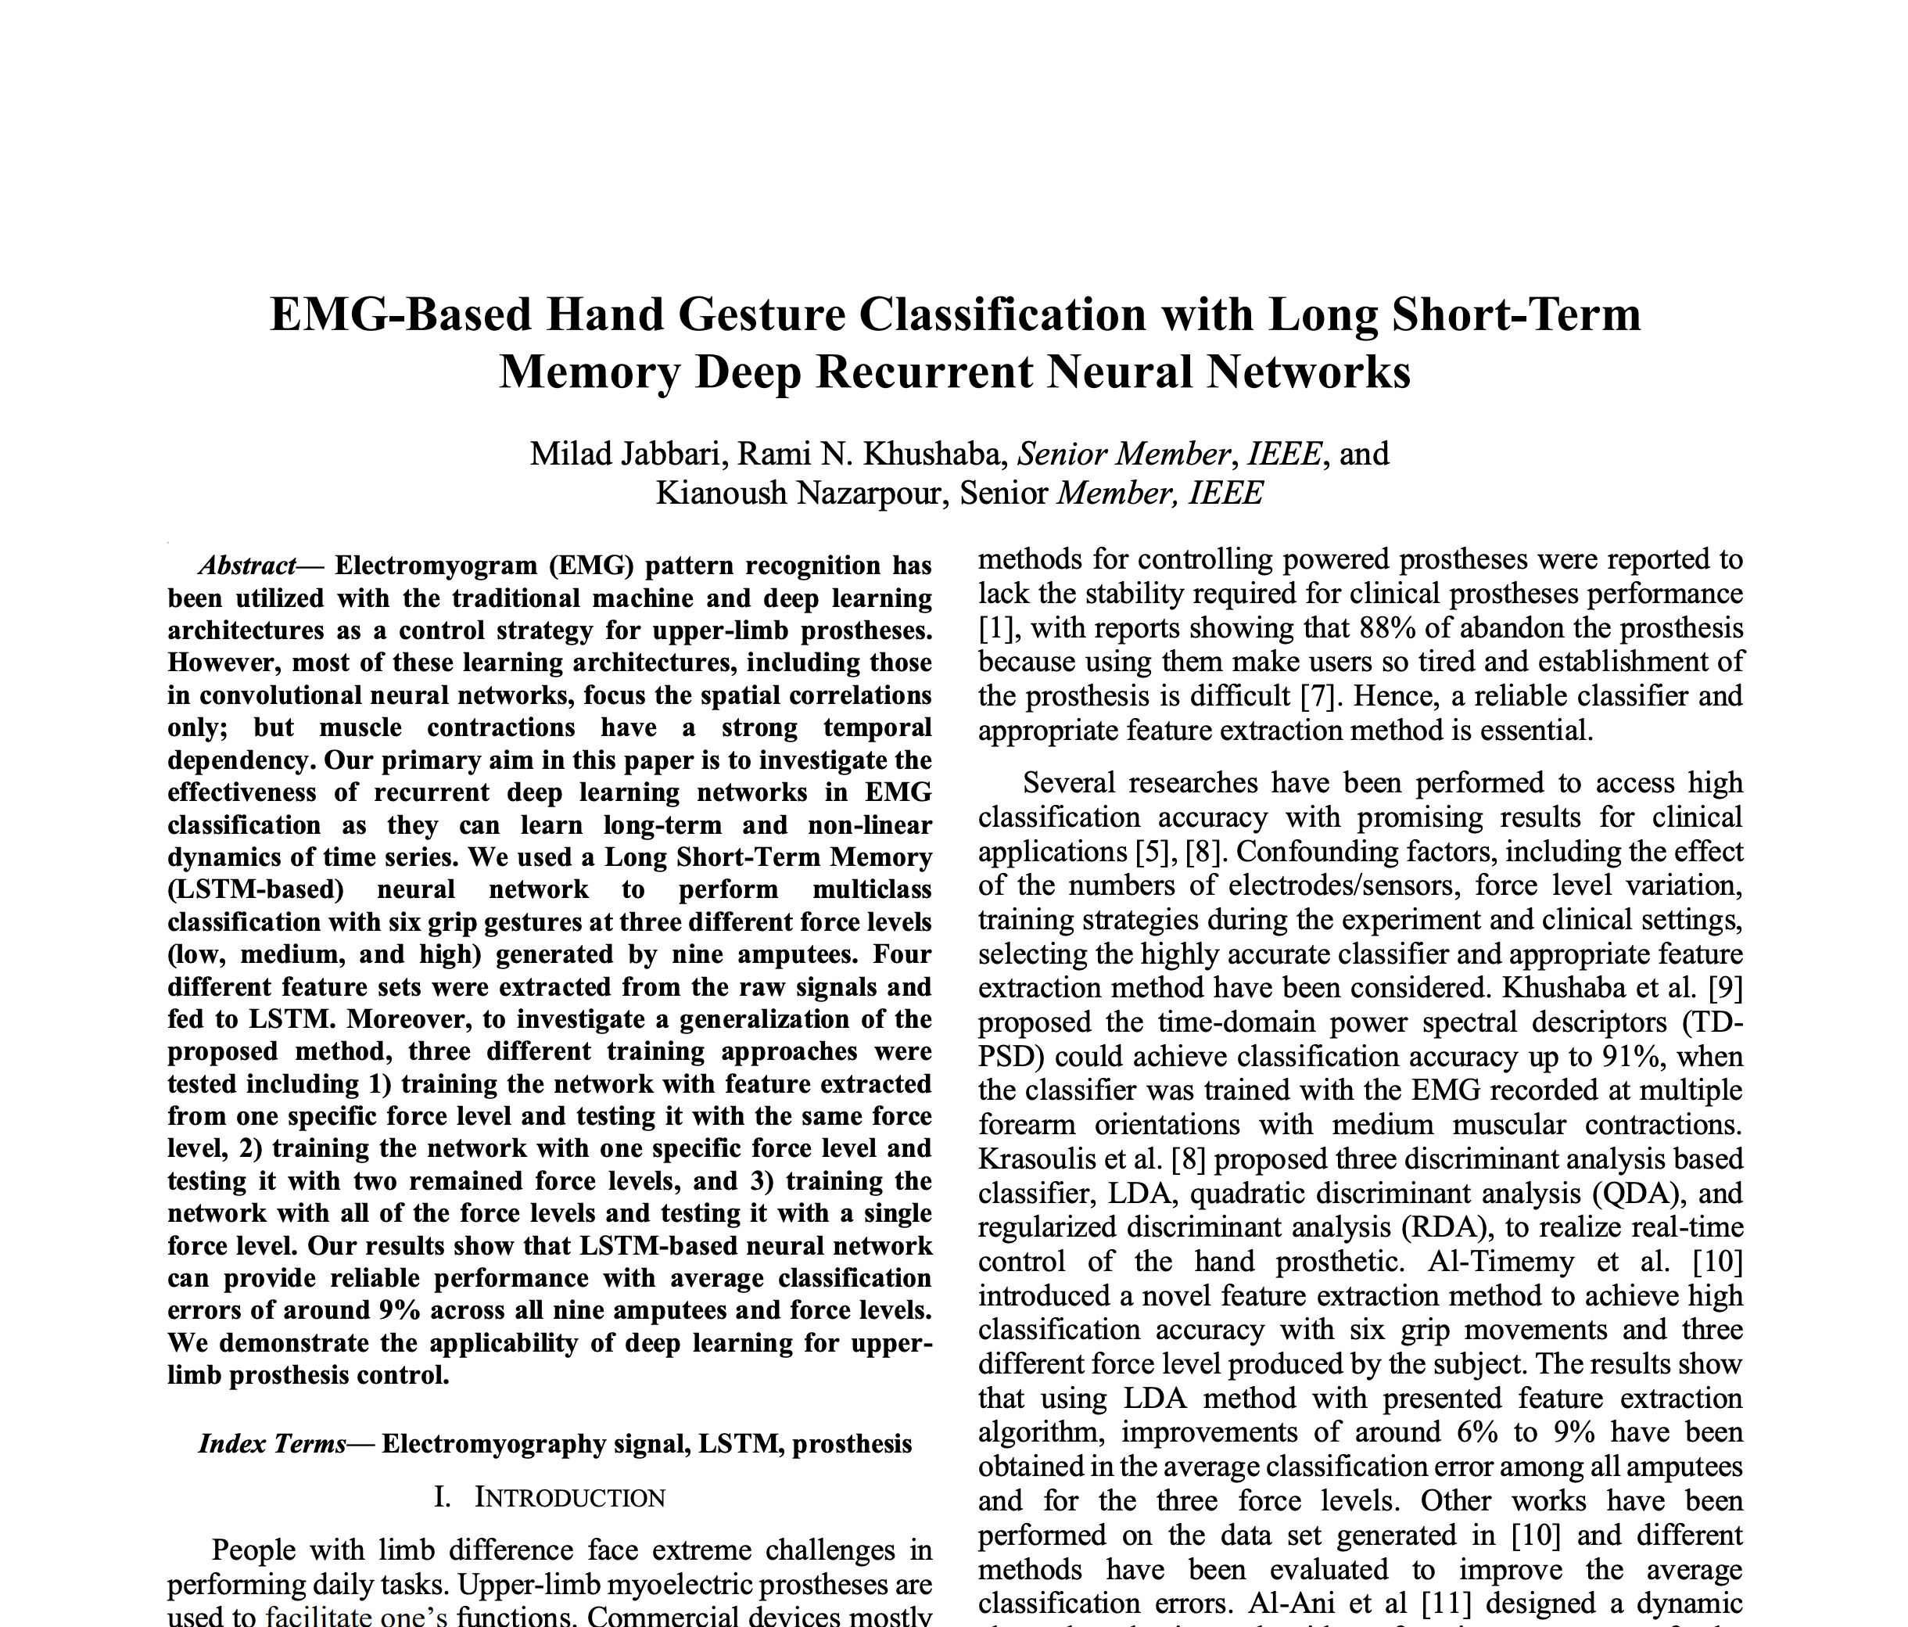
Related Work
Notes:
There are also studies that have implemented deep learning algorithms such as CNNs and LSTMs to classify EMG data. For example, this study uses LSTM networks to achieve error rates lower than 10%. However, these types of networks suffer from performance issues.

Slide 7
Our Approach
SVM
Established approach
FFNN
Established approach
LSTM
Novel approach
Notes:
In this presentation, we will present a comparison of three gesture classification techniques applied to an EMG dataset with four types of hand gestures. The gesture classification techniques used include Support Vector Machines (SVM) and Feed-Forward Neural Networks (FFNN) using the traditional pre-processing technique. We also have LSTM networks processed using a novel technique that we hope will speed up training time while maintaining good accuracy.

Slide 8
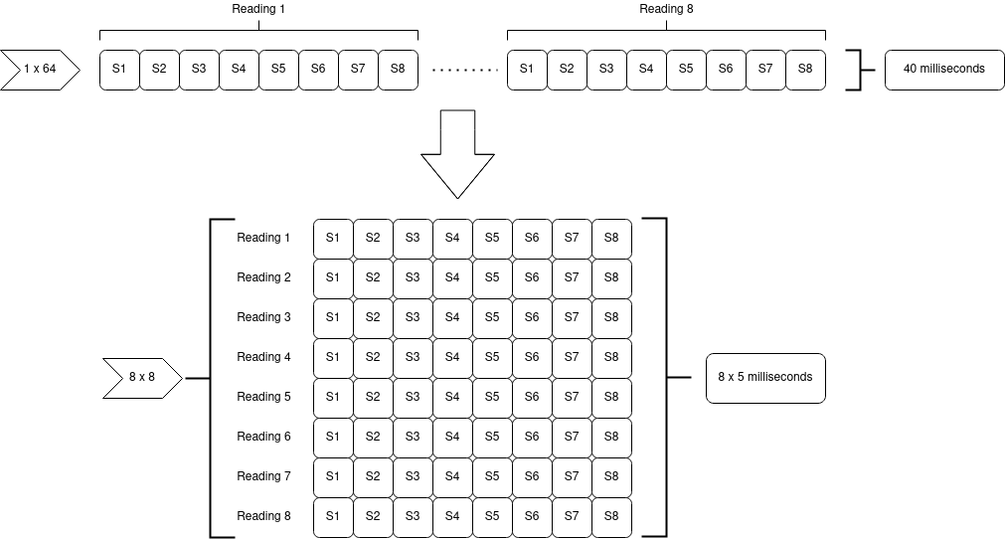
Data Preparation (Established Methods)

Slide 9
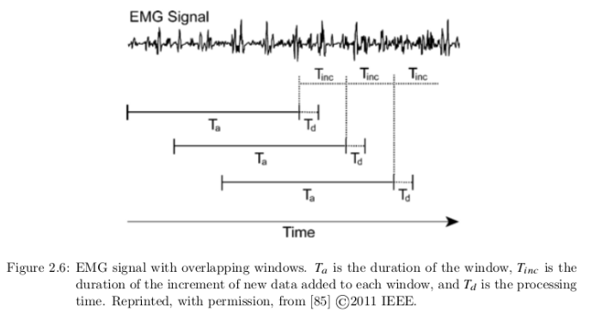
Data Preparation (Established Methods)

Slide 10
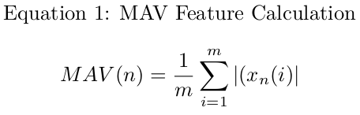
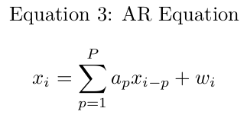
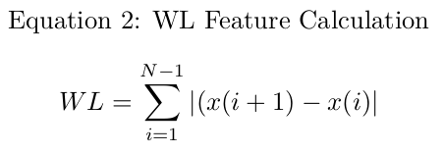
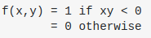
Feature Extraction (Established Methods)
Equation 4: Zero Crossing

Slide 11
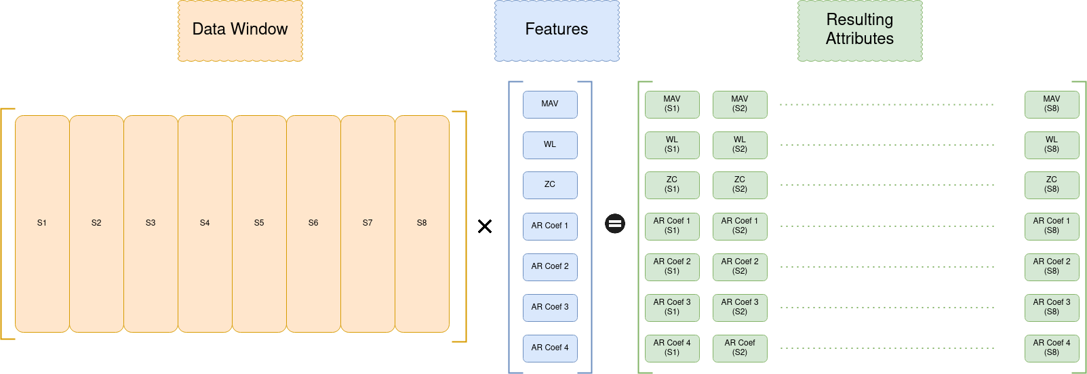
Feature Extraction (Established Methods)

Slide 12
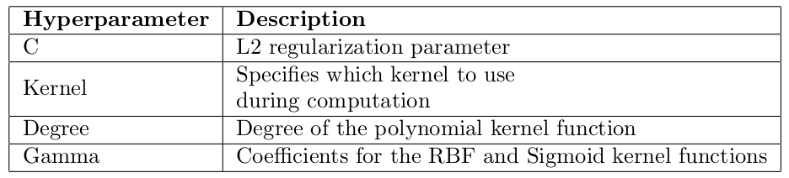
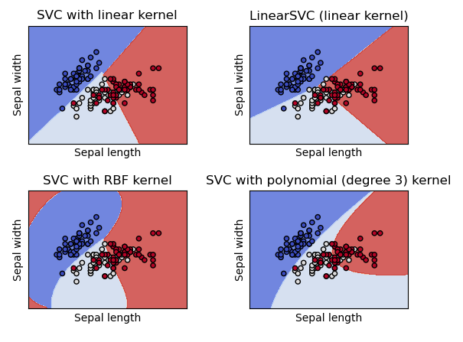
Model Implementation - SVC (Established Methods)

Slide 13
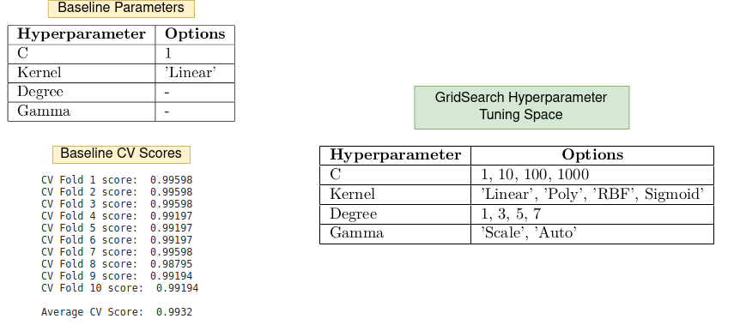
Model Implementation - SVC (Established Methods)

Slide 14
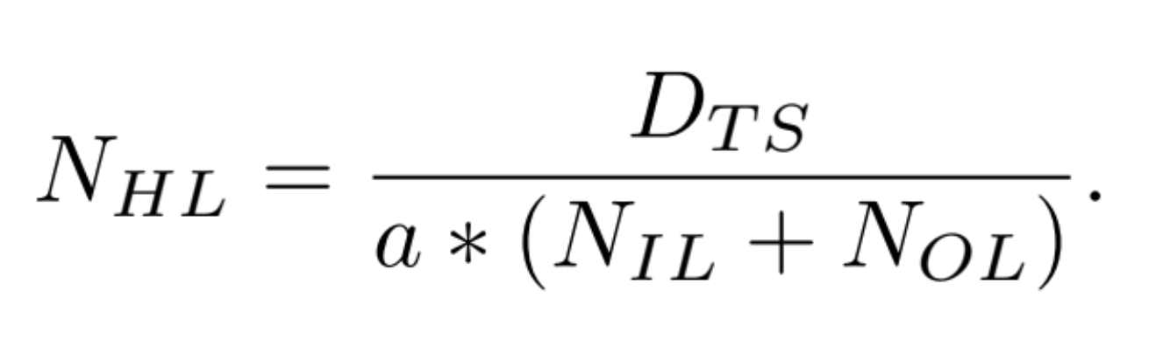
Model Implementation - FFNN (Established Methods)
0 - 2 hidden layers
Optimal Number of Neurons in Hidden Layers
•
•
•
56 neurons
4,6,8 neurons
4,6,8 neurons
4 neurons
Notes:
Our Feed-Forward Neural Network used the traditional processing approach that Chris explained. The input layer had 56 neurons as there are 56 features being input into the network. The output layer had 4 neurons to support our softmax activation function in the last layer. In our tuning we tried 0-2 hidden layers with 4,6, or 8 neurons each. We determined the optimal number of neurons in the hidden layer by using this equation where Dts is the number of data points in the training set and Nil and Nol are the number of neurons in the input and output layers respectively. The variable a was varied from 4 to 10 in order to prevent overfitting. This resulted in using 4, 6, and 8 neurons in the hidden layers.

Slide 15
Model Implementation - FFNN (Established Methods)
Hyper Parameter | Options
Number of Hidden Layers | 0, 1, 2
Neurons in Hidden Layers | 4, 6, 8
Learning Function | Adam, SGD
Learning Rate | 0.001,0.01,0.05,0.1,0.2,0.3,0.4
Activation Function | Relu, elu, sigmoid
Notes:
Here is a table that summarizes the details of our hyperparameter tuning. We tuned the number of hidden layers and the number of neurons in the hidden layers first. After we landed on the optimal structure, we then tuned the learning function, learning rate and activation function in a grid search. After the hyperparameter tuning, the best model was tested using test data.

Slide 16
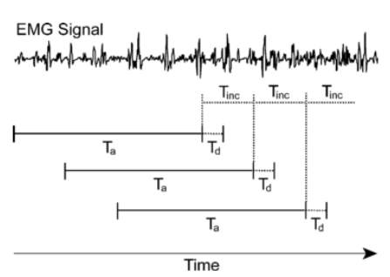
LSTM – Data Preparation

Slide 17
LSTM – Data Preparation
# of windows
# of elements
# of EMG channels

Slide 18
LSTM – Architecture
1
1
1
2
2
2
.
.
.
.
.
.
Dropout: 20%
3
4
50
100
LSTM Layer
Dense Layer
(ReLU)
Output
(Softmax)

Slide 19
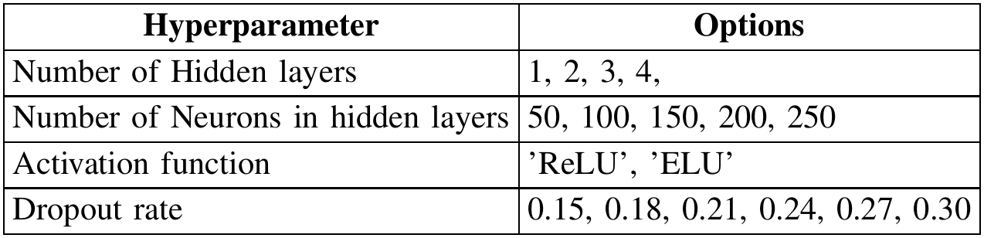
LSTM – Tuning

Slide 20
Results

Slide 21
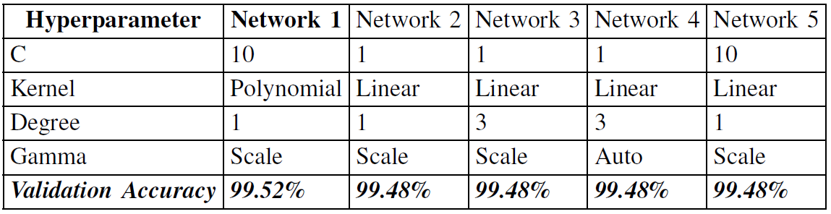
SVM – Tuning Results

Slide 22
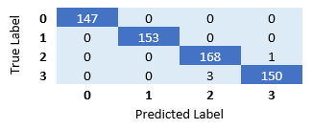
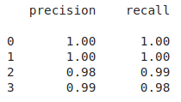
SVM – Confusion Matrix

Slide 23
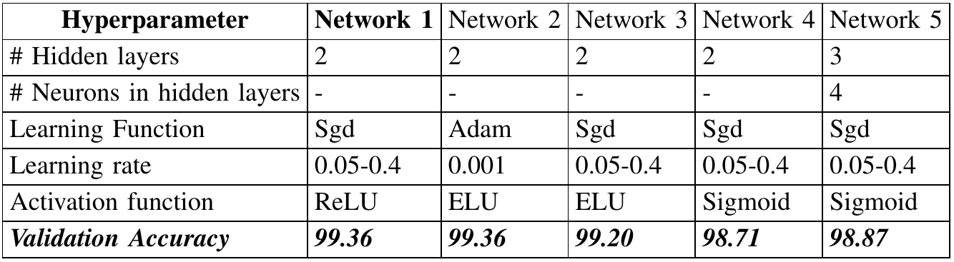
FFNN – Tuning Results

Slide 24
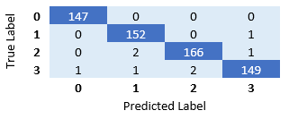
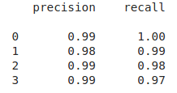
FFNN – Confusion Matrix

Slide 25
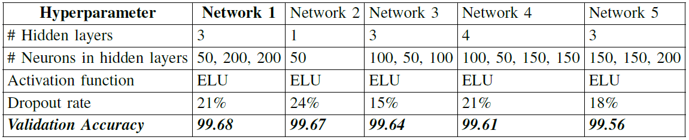
LSTM – Tuning Results

Slide 26
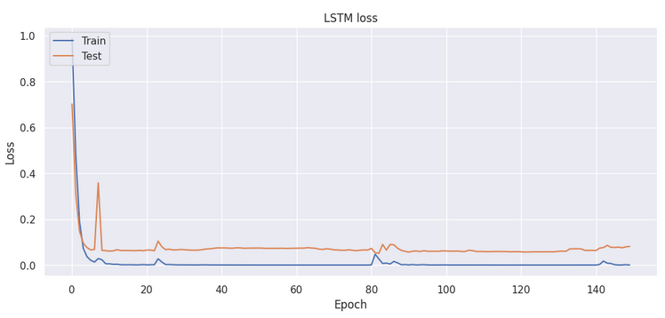
LSTM – Training Loss

Slide 27
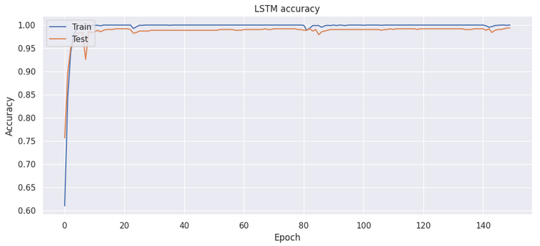
LSTM – Observed Accuracy

Slide 28
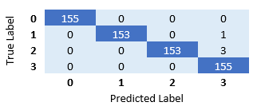
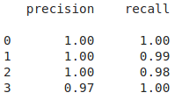
LSTM – Confusion Matrix

Slide 29
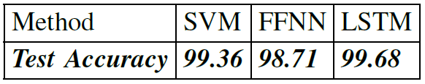
Model Comparison

Slide 30


